Slide 1
Capstone Presentation
J. Alex Huerta
Thinkful Final Project, January 2022

Slide 2

Project Overview
Analysis of video game sales data
Notes:
For my final Capstone project, I intend to pull out interesting and relevant trends from a large dataset on video game sales.
This dataset pulls from vgchartz.com, which is a relatively small company that aggregates public sale data for video games all over the world to project overall sales. Because their methodologies are not public and because they are making projections, their data will never be 100% reliable. However, since their projections are large in scope and cover the entire industry, their dataset is more complete than any official manufacturer data. For our purposes, in pulling out interesting trends and finding correlations, accuracy will not be an issue.
While I initially found this dataset on Kaggle, it was created via this Github script. Because the format of the date on vgcharts is e.g. "25th Jun 89", I had to do some parsing and cleaning to get it into a machine-readable state. I edited lines 84 through 104 as well as a few small other changes.
After I reworked this section of code, of course, I discovered more fundamental issues with the data source. The website has changed formats over the years since this scraper was first written, and SSL (encrypted browsing) has become the norm. I spent a significant amount of time experimenting with the scraper and working on github to find other forks that had fixed problems that cropped up.
As part of this process, I discovered that vgchartz stopped making software sales estimates as of 2018. As a result, I have decided to change the scope of this project slightly. Rather than focus on pandemic-related sales changes, I am going to focus on other trends.

Slide 3
Project Overview
Analysis of video game sales data
Source: vgchartz.com
Notes:
For my final Capstone project, I intend to pull out interesting and relevant trends from a large dataset on video game sales.
This dataset pulls from vgchartz.com, which is a relatively small company that aggregates public sale data for video games all over the world to project overall sales. Because their methodologies are not public and because they are making projections, their data will never be 100% reliable. However, since their projections are large in scope and cover the entire industry, their dataset is more complete than any official manufacturer data. For our purposes, in pulling out interesting trends and finding correlations, accuracy will not be an issue. **This data includes information on game name, platform, release year, genre,, and global sales. There are other fields, but those are the relevant ones for our purposes**
While I initially found this dataset on Kaggle, it was created via this Github script. Because the format of the date on vgcharts is e.g. "25th Jun 89", I had to do some parsing and cleaning to get it into a machine-readable state. I edited lines 84 through 104 as well as a few small other changes.
After I reworked this section of code, of course, I discovered more fundamental issues with the data source. The website has changed formats over the years since this scraper was first written, and SSL (encrypted browsing) has become the norm. I spent a significant amount of time experimenting with the scraper and working on github to find other forks that had fixed problems that cropped up.
As part of this process, I discovered that vgchartz stopped making software sales estimates as of 2018. As a result, I have decided to change the scope of this project slightly. Rather than focus on pandemic-related sales changes, I am going to focus on other trends.

Slide 4
Project Overview
Analysis of video game sales data
Source: vgchartz.com
Python scraping script via Kaggle/github
Notes:
For my final Capstone project, I intend to pull out interesting and relevant trends from a large dataset on video game sales.
This dataset pulls from vgchartz.com, which is a relatively small company that aggregates public sale data for video games all over the world to project overall sales. Because their methodologies are not public and because they are making projections, their data will never be 100% reliable. However, since their projections are large in scope and cover the entire industry, their dataset is more complete than any official manufacturer data. For our purposes, in pulling out interesting trends and finding correlations, accuracy will not be an issue.
While I initially found this dataset on Kaggle, it was created via this Github script. Because the format of the date on vgcharts is e.g. "25th Jun 89", I had to do some parsing and cleaning to get it into a machine-readable state. I edited lines 84 through 104 as well as a few small other changes.
After I reworked this section of code, of course, I discovered more fundamental issues with the data source. The website has changed formats over the years since this scraper was first written, and SSL (encrypted browsing) has become the norm. I spent a significant amount of time experimenting with the scraper and working on github to find other forks that had fixed problems that cropped up.
As part of this process, I discovered that vgchartz stopped making software sales estimates as of 2018. As a result, I have decided to change the scope of this project slightly. Rather than focus on pandemic-related sales changes, I am going to focus on other trends.

Slide 5
Project Overview
Analysis of video game sales data
Source: vgchartz.com
Python scraping script via Kaggle/github
Forked/Altered based on needs
Notes:
For my final Capstone project, I intend to pull out interesting and relevant trends from a large dataset on video game sales.
This dataset pulls from vgchartz.com, which is a relatively small company that aggregates public sale data for video games all over the world to project overall sales. Because their methodologies are not public and because they are making projections, their data will never be 100% reliable. However, since their projections are large in scope and cover the entire industry, their dataset is more complete than any official manufacturer data. For our purposes, in pulling out interesting trends and finding correlations, accuracy will not be an issue.
While I initially found this dataset on Kaggle, it was created via this Github script. Because the format of the date on vgcharts is e.g. "25th Jun 89", I had to do some parsing and cleaning to get it into a machine-readable state. I edited lines 84 through 104 as well as a few small other changes.
After I reworked this section of code, of course, I discovered more fundamental issues with the data source. The website has changed formats over the years since this scraper was first written, and SSL (encrypted browsing) has become the norm. I spent a significant amount of time experimenting with the scraper and working on github to find other forks that had fixed problems that cropped up.
As part of this process, I discovered that vgchartz stopped making software sales estimates as of 2018. As a result, I have decided to change the scope of this project slightly. Rather than focus on pandemic-related sales changes, I am going to focus on other trends.

Slide 6
Project Overview
Analysis of video game sales data
Source: vgchartz.com
Python scraping script via Kaggle/github
Forked/Altered based on needs
VGChartz analysis is limited
Notes:
For my final Capstone project, I intend to pull out interesting and relevant trends from a large dataset on video game sales.
This dataset pulls from vgchartz.com, which is a relatively small company that aggregates public sale data for video games all over the world to project overall sales. Because their methodologies are not public and because they are making projections, their data will never be 100% reliable. However, since their projections are large in scope and cover the entire industry, their dataset is more complete than any official manufacturer data. For our purposes, in pulling out interesting trends and finding correlations, accuracy will not be an issue.
While I initially found this dataset on Kaggle, it was created via this Github script. Because the format of the date on vgcharts is e.g. "25th Jun 89", I had to do some parsing and cleaning to get it into a machine-readable state. I edited lines 84 through 104 as well as a few small other changes.
After I reworked this section of code, of course, I discovered more fundamental issues with the data source. The website has changed formats over the years since this scraper was first written, and SSL (encrypted browsing) has become the norm. I spent a significant amount of time experimenting with the scraper and working on github to find other forks that had fixed problems that cropped up.
As part of this process, I discovered that vgchartz stopped making software sales estimates as of 2018. As a result, I have decided to change the scope of this project slightly. Rather than focus on pandemic-related sales changes, I am going to focus on other trends.

Slide 7
Hypotheses
Hypothesis One:
H_{a}: There is a statistically significant increase in the sales of Sports games in 2015 vs 2005.
H₀: There is no significant difference in sports games sales between 2015 and 2005
Notes:
Sports games have moved to annual releases in many series, and I expect the plethora of options available in more recent years have increased sales.
H2a: There is a statistically significant increase in PC game sales in 2008 vs 2012. Minecraft was released in 2011, and it proved to be so popular that I expect PC gaming took off as a result.
H20: There is no statistically significant change in PC game sales in 2010 vs 2015.
Bonus: I'm also interested in comparing all sales of games for PC vs all consoles.

Slide 8
Hypotheses
Hypothesis One:
H_{a}: There is a statistically significant increase in the sales of Sports games in 2015 vs 2005.
H₀: There is no significant difference in sports games sales between 2015 and 2005
Hypothesis Two:
H_{a}: There is a statistically significant increase in PC game sales between 2008 and 2012
H₀: There is no significant difference in PC game sales between 2008 and 2012
Notes:
Bonus: I'm also interested in comparing all sales of games for PC vs all consoles.

Slide 9
Hypotheses
Hypothesis One:
H_{a}: There is a statistically significant increase in the sales of Sports games in 2015 vs 2005.
H₀: There is no significant difference in sports games sales between 2015 and 2005
Hypothesis Two:
H_{a}: There is a statistically significant increase in PC game sales between 2008 and 2012
H₀: There is no significant difference in PC game sales between 2008 and 2012
Bonus:
What statistically significant correlations can be found between PC and console sales?
Notes:
Bonus: I'm also interested in comparing all sales of games for PC vs all consoles.

Slide 10
Data Cleaning & Initial Testing
Import data into python
Examine contents, remove unneeded columns, clean null listings, correct data types
Look at unique genre, platform entries to confirm spelling, etc.
Combine Sports and Racing genres together for our analysis
Add flag for PC vs console games
Add randomly generated column for later sorting
Notes:
All of this was fairly standard

Slide 11


Sports Analysis
Create groups for sports/racing games released in 2005 vs 2015
Create subgroups via “random” flag for a-a testing
Evaluate sample size/sanity check
Notes:
Sample sizes for these groups varied – the Sports/Racing group from 2005 had just over 200 entries, and the group for 2015 only had about 80
Both groups were internally consistent

Slide 12
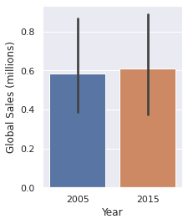
Sports Analysis
A-B testing for 2005 vs 2015:
P-value of 0.898
Note the error bars
Notes:
Null Hypothesis holds true, here.
Further exploration of this?

Slide 13
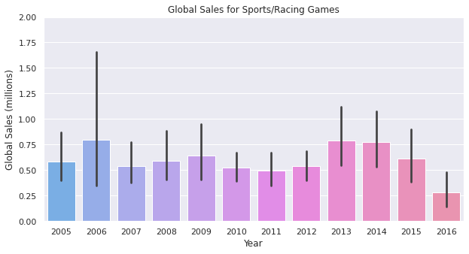
Sports/Racing sales, 2005-2016
Notes:
If we look at bar plots for all of the years of sports/racing sales between our selected years, we can see that there is a great deal of variance but no obvious trend. Most years have a great deal of overlap in the standard confidence interval. To further examine any trends for this time period we can look at another graph.

Slide 14
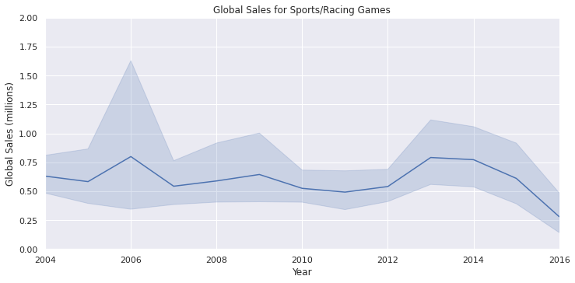
Sports/Racing sales, 2004-2016
Notes:
Endpoints this were tweaked slightly to maintain a cleaner line. Now we can see a certain ebb and flow of sales without there being any particular trend.

Slide 15


PC Game Sales Analysis
Reason for these particular years
Filter directly from original dataframe (as opposed to sports/racing analysis)
Filter to PC games, then group by year
Sample size check
Notes:
Part of the reason I based the analysis around these particular years is that Minecraft, which proved to be a formative PC game, was released in 2011 and based on the scope of vgchartz’ data, that seemed like a solid place to start.
We have about 80 results for games released in 2008 and 60 for the year 2012.
Skipped A-A testing here because of the small sample size, meaning internal consistency of sales is not really necessary or expected

Slide 16
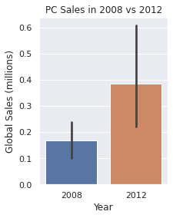
PC Game Sales Analysis
A-B testing for 2008 vs 2012:
P-value of 0.0277
Correlation of 2.2
Relatively weak, but p value is over the threshold of .05
Notes:
We have a correlation here. Relatively large error bars because of the small sample sizes, but certainly a statistically significant increase in sales. Now to look at the bigger picture:

Slide 17
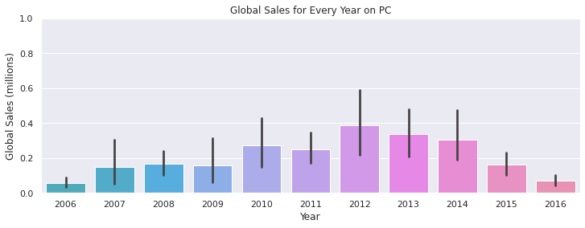
PC Game Sales, 2006-2016
Notes:
A line plot will help us take another look at this data:

Slide 18
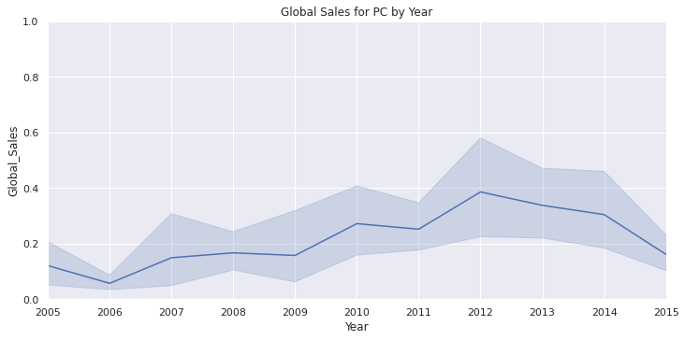
Sports/Racing sales, 2004-2016
Notes:
Note that the Y scale here is different than the sports game analysis, as PC gaming is a relatively smaller market when you segment by platform. Now we can visualize the rise in PC gaming that peaked around 2012.

Slide 19


Bonus: PC vs Console games
Simple setup, building off our previous analysis
Use flag for pc vs not-PC
Filter into two groups
Sample size check
Notes:
Part of the reason I based the analysis around these particular years is that Minecraft, which proved to be a formative PC game, was released in 2011 and based on the scope of vgchartz’ data, that seemed like a solid place to start.
We have about 80 results for games released in 2008 and 60 for the year 2012.
Skipped A-A testing here because of the small sample size, meaning internal consistency of sales is not really necessary or expected

Slide 20
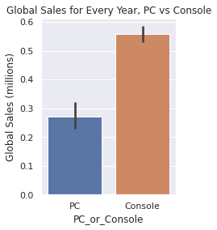
PC vs Console games
A-B testing for PC vs Console:
P-value of less than .001
Correlation of 5.46
Notes:
As we can see, there is a significant difference in these two groupings. Let's look at some visualizations to get a better idea of the difference.

Slide 21
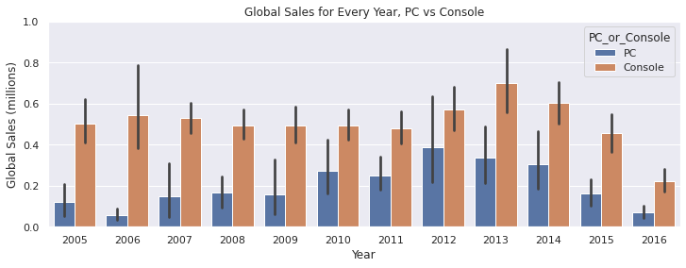
PC vs Console games, 2005-2016
Notes:
This provides some very useful information, in that we can see an uptick in PC gaming around 2012 (which was when many blockbuster PC games were released), and a separate peak in non-PC gaming in 2013. Some of the reduction in numbers towards the end of this time period could actually be ascribed to digital-only sales, as vgchartz has stated they had difficulty making estimates for those sales. This may be easier to visualize in a line graph or a histogram:

Slide 22
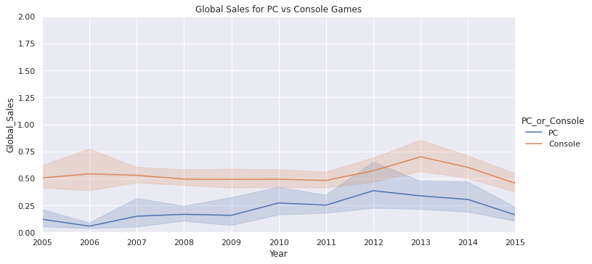
PC vs Console games, 2004-2016
Notes:
We can see a definite dip approaching the end of the dataset, which we can attribute, again, to vgchartz's difficulty in estimating digital sales. That being said, the trends we noticed in our 2005-2015 range still hold.

Slide 23
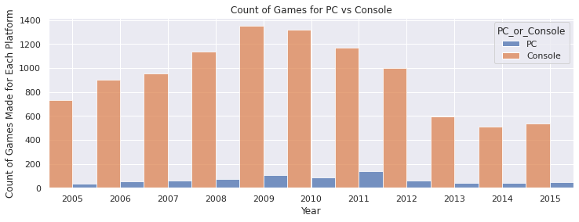
PC vs Console games, 2004-2016
Notes:
We can see a definite dip approaching the end of the dataset, which we can attribute, again, to vgchartz's difficulty in estimating digital sales. That being said, the trends we noticed in our 2005-2015 range still hold. Interestingly, we can see from the histogram that there are a vastly larger number of different console games being sold, which tells us there isn't as much variety in the PC gaming world (and that games in the PC world quite possibly have greater individual sales, which could be a matter of price or of volume - something beyond the scope of this analysis).

Slide 24
Conclusion and Recommendations
Notes:
This analysis was a great learning experience, in terms of starting at the very beginning of understanding where a dataset comes from, the difficulties of organizing and creating the dataset, as well as the actual analysis. We pulled out some interesting trends in terms of year-to-year sales, genre, and platform, which would prove useful to executives trying to make decisions for their game companies. Based on this data, I would urge companies to explore the possibility of increasing the games released for PC, as we see there is a dearth of variety in PC games even though the platform itself is robust and versatile. (And, indeed, in 2021 and 2022 more publishers have begun to release games for the PC!) I also would urge publishers to share more of their real-world sales data for the benefit of consumers and all companies, as projecting analysis these days can be extremely difficult without physical sales to track. I would be curious to integrate more complete data from 2018-present into this dataset, but for now these results will stand on their own.

Slide 25
Conclusion and Recommendations
Learning experience in terms of dataset analysis, cleaning, and reliability
Useful trends for YoY sales in terms of genre and platform
Growth of PC games
Where is the public data for digital sales?
Notes:
This analysis was a great learning experience, in terms of starting at the very beginning of understanding where a dataset comes from, the difficulties of organizing and creating the dataset, as well as the actual analysis. We pulled out some interesting trends in terms of year-to-year sales, genre, and platform, which would prove useful to executives trying to make decisions for their game companies. Based on this data, I would urge companies to explore the possibility of increasing the games released for PC, as we see there is a dearth of variety in PC games even though the platform itself is robust and versatile. (And, indeed, in 2021 and 2022 more publishers have begun to release games for the PC!) I also would urge publishers to share more of their real-world sales data for the benefit of consumers and all companies, as projecting analysis these days can be extremely difficult without physical sales to track. I would be curious to integrate more complete data from 2018-present into this dataset, but for now these results will stand on their own.

Slide 26

Methods and Notes
Pyplot for t-tests
Pandas for dataframe andfiltering
Seaborn w/ matlab
Colab Notebook – ready to format as discrete program for issuing reports
Notes:
One final note: I assigned discrete variables to most of the graphs and t-test results of this report. The intention is to format this Python project in such a way to produce a completed document, for use in non-Jupyter formats. I intend to implement this feature when I share a version of this project on Git, but I am not including it in this version.

Slide 27

Thank you!
Notes:
Let me know if you have any questions or want clarification!

